Slide 1
Supply Chain Management
Extensibility
Notes:
Now it is time to describe and demonstrate the Dynamics 365 Extensibility features.

Slide 2
Introduction
Extension model
Best of breed development tools
ISV Solutions
Low code / No code
Notes:
We will start by presenting our pro-code extensibility model and give a demonstrate of this in action, then describe our tool set – which we also share with ISVs, so we’ll provide an overview of some of the solution built by our ecosystem, and finally we will describe and demonstrate ways to extend Dynamics 365 SCM using Low code no code approaches, making it possible for basically anyone to extend the product, without writing any code or requiring a computer science degree.

Slide 3
Extension model
Notes:
Let’s start with a look at our Pro-Code capabilities.

Slide 4

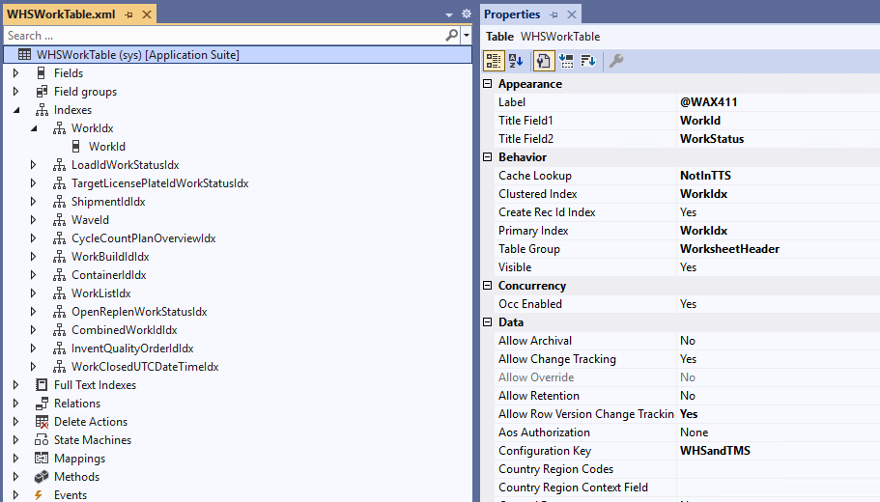
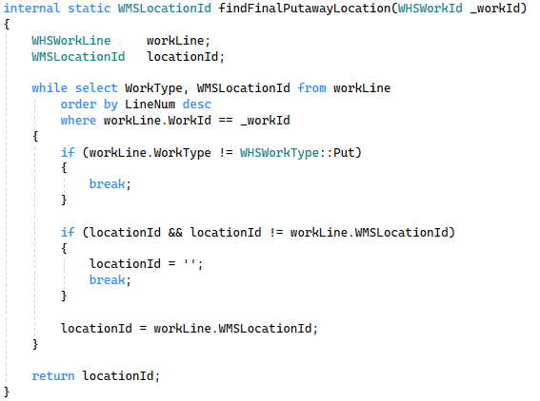

Dynamics 365 Development
Model driven
Code behind – X++
Focus on business domain, not technical details
Simplifies all common patterns
Designed to create business solutions
Object Oriented .NET language – like C#
Strongly typed data integration – SQL-like syntax
Rapid development with rich extensibility capabilities
Notes:
Creating business solutions in D365 has been streamlined for max productivity and focus over decades. Firstly, enabling builders to define behaviors with very few gestures using a model driven development approach. This enables extraordinary productivity, as many scenarios can be created without a single line of code written. We often hear stories about pre-sellers creating working demos of custom specific requirements– solutions the pre-sales team created in short time as a preparation for the pre-sales meeting.
Naturally, not everything can be expressed in a model – regardless of how rich it is. That’s why we also have a .NET language, named X++, to support everything else. X++ is a .NET language, making it work seamlessly with every other .NET component, giving nearly endless integration possibilities. As indicated by the blue arrow, this drives rapid development with a high ROI. Both for Microsoft engineers and external developers.

Slide 5
Adaptable
Meets daily business requirements
Rich ecosystem
Upgradable
No risk of getting stuck with an old ERP
Upgrades are automatic Standard code cannot be changed
Operational
High availability
Innovative
Continuous delivery of value
4 yearly releases,
All customers on a recent version 90% within 1 release (3 months) 100% within 3 release (9 months)
High productivity
24x7 support Full stack supported by Microsoft Best-of-breed infrastructure for all customers
38 so far
Monthly Proactive Quality Updates,
Driving near-zero-downtime
Best-of-breed toolset
30k monthly engineers in
10k organizations created
65k solutions
Notes:
Let’s talk about some of the driving forces behind our architectural design.
From a customer perspective an ERP system must be able to meet the daily and evolving business requirements. You want an adaptable system that can grow with your business. With Dynamics we have a thriving ecosystem with 30k active engineers, and 65k solutions.
Equally important, you want an upgradable ERP system. Getting stuck on an old system would be a nightmare – That will never happen with Dynamics. We have a continuous update model, regardless of how extended the system is – in fact all our customers are running a recent version of our system.
On top that, you have the entire talent of Microsoft’s to ensure a system with high availability, including 24x7 support and the best possible cloud infrastructure.
By embracing a cloud-first mindset. Microsoft brings innovations like new capabilities to all customers 4 times per year, on top of that monthly quality updates are provided, typically with compliance, reliability, and performance improvements.
This brings us back to how to upgrade a system that is adapted. We guarantee all extensions will keep working, and we have become so great at it, that all of this happens automatically – No human actions are required. All systems are upgraded and running again within the hour.
Let’s look at how we made that possible.

Slide 6
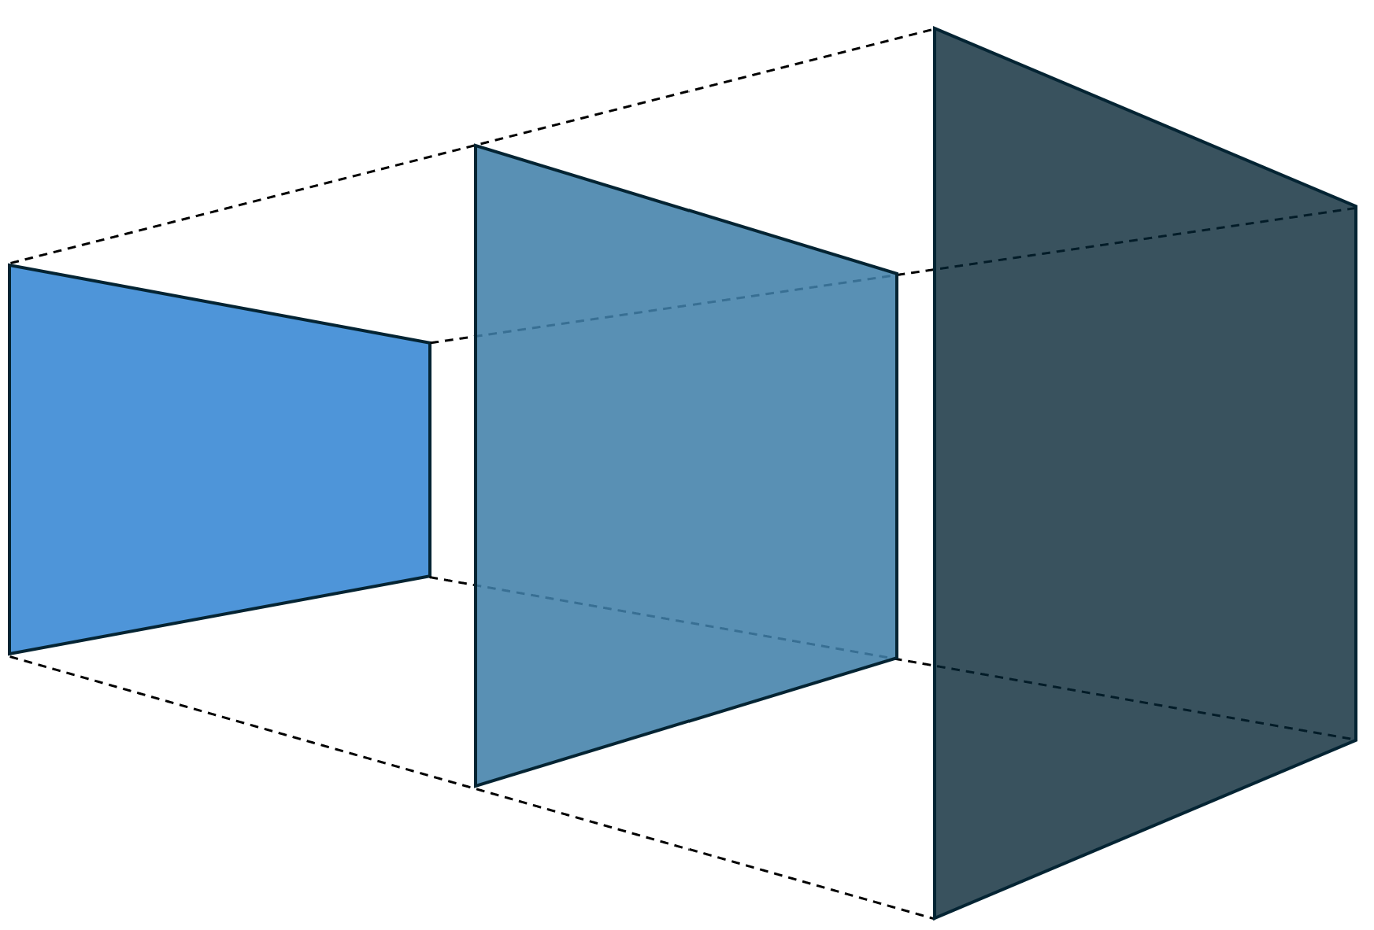
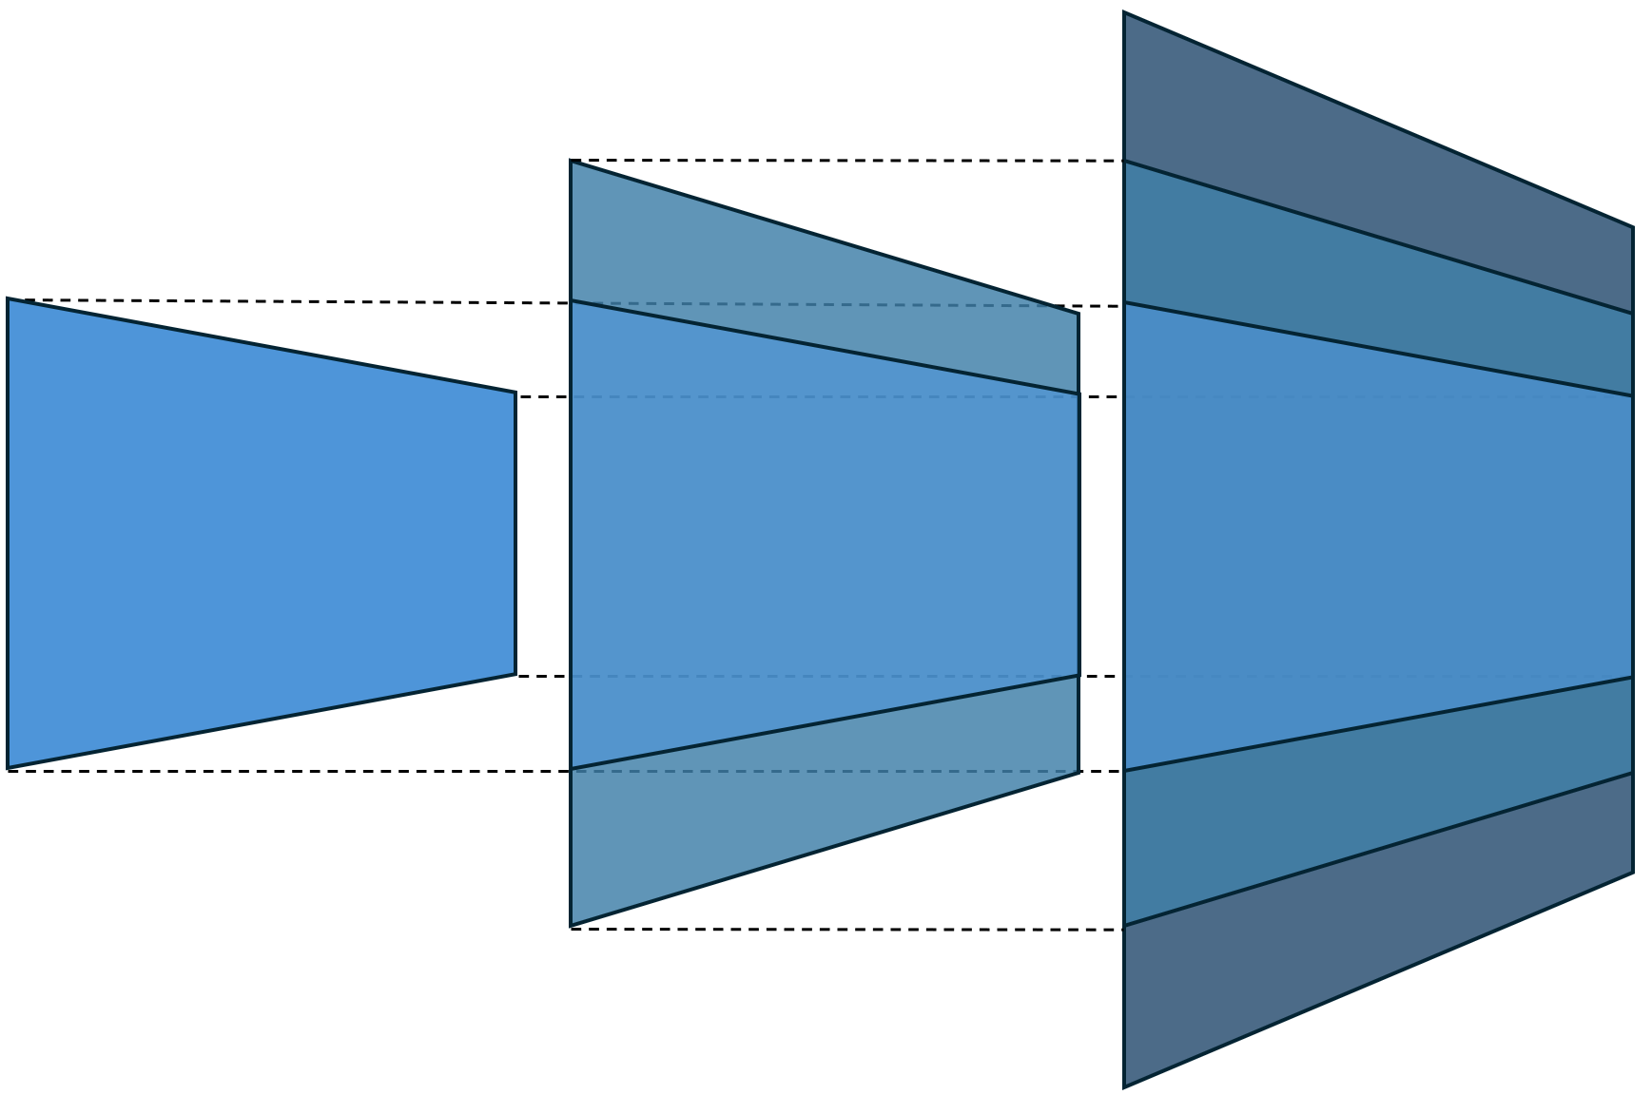
The paradigm shift
 | Customization | Extension
What | Change, add and create | Add and create
How | Overwrite | Wrap
 | 1:1 | 1:n
Upgrading | Pull model Yearly releases with manually merge of conflicts | Continuous update Several releases per year, fully automated deploy
Era | Dynamics AX 2012 On-premise | Dynamics 365 Supply Chain Management Cloud
Notes:
If you speak with our customers, you may hear about customers needing to manage their customizations and having significant issues with upgrading. These customers are running a deprecated version, like Dynamics AX 2012, on-premises. The extension model used in that product enabled overwriting of pretty much everything. That means each upgrade requires a manual conflict resolution, meaning customers stay on old versions.
Now, this is very different from the product we are talking about today – Dynamics 365 SCM – here we retained the powerful development approach, and we enabled it in an extensible way – you can no longer overwrite, you can wrap the underlying code. This means that there are by-design no conflicts to resolve, and we can seamlessly upgrade all systems. It is powerful, elegant and game changing.

Slide 7
Best of breed development tools
Notes:
Now let us talk about the tools in the toolbox.

Slide 8
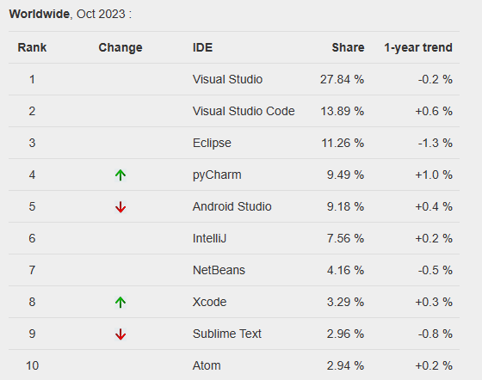
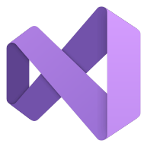
Microsoft Visual Studio
The most used IDE in the world
Supports >40 languages, incl. C#, C++, TypeScript
Not just for ERP
Easy to recruit engineers
Quick learning curve
TOP IDE index (pypl.github.io)
Notes:
Visual Studio is where all D365 pro-code happens. It is by a far margin the most used development environment. Not just for ERP systems, but for any software development. This is important as attracting talent can be hard, and by using a well-known tool, engineers ramp up faster.

Slide 9
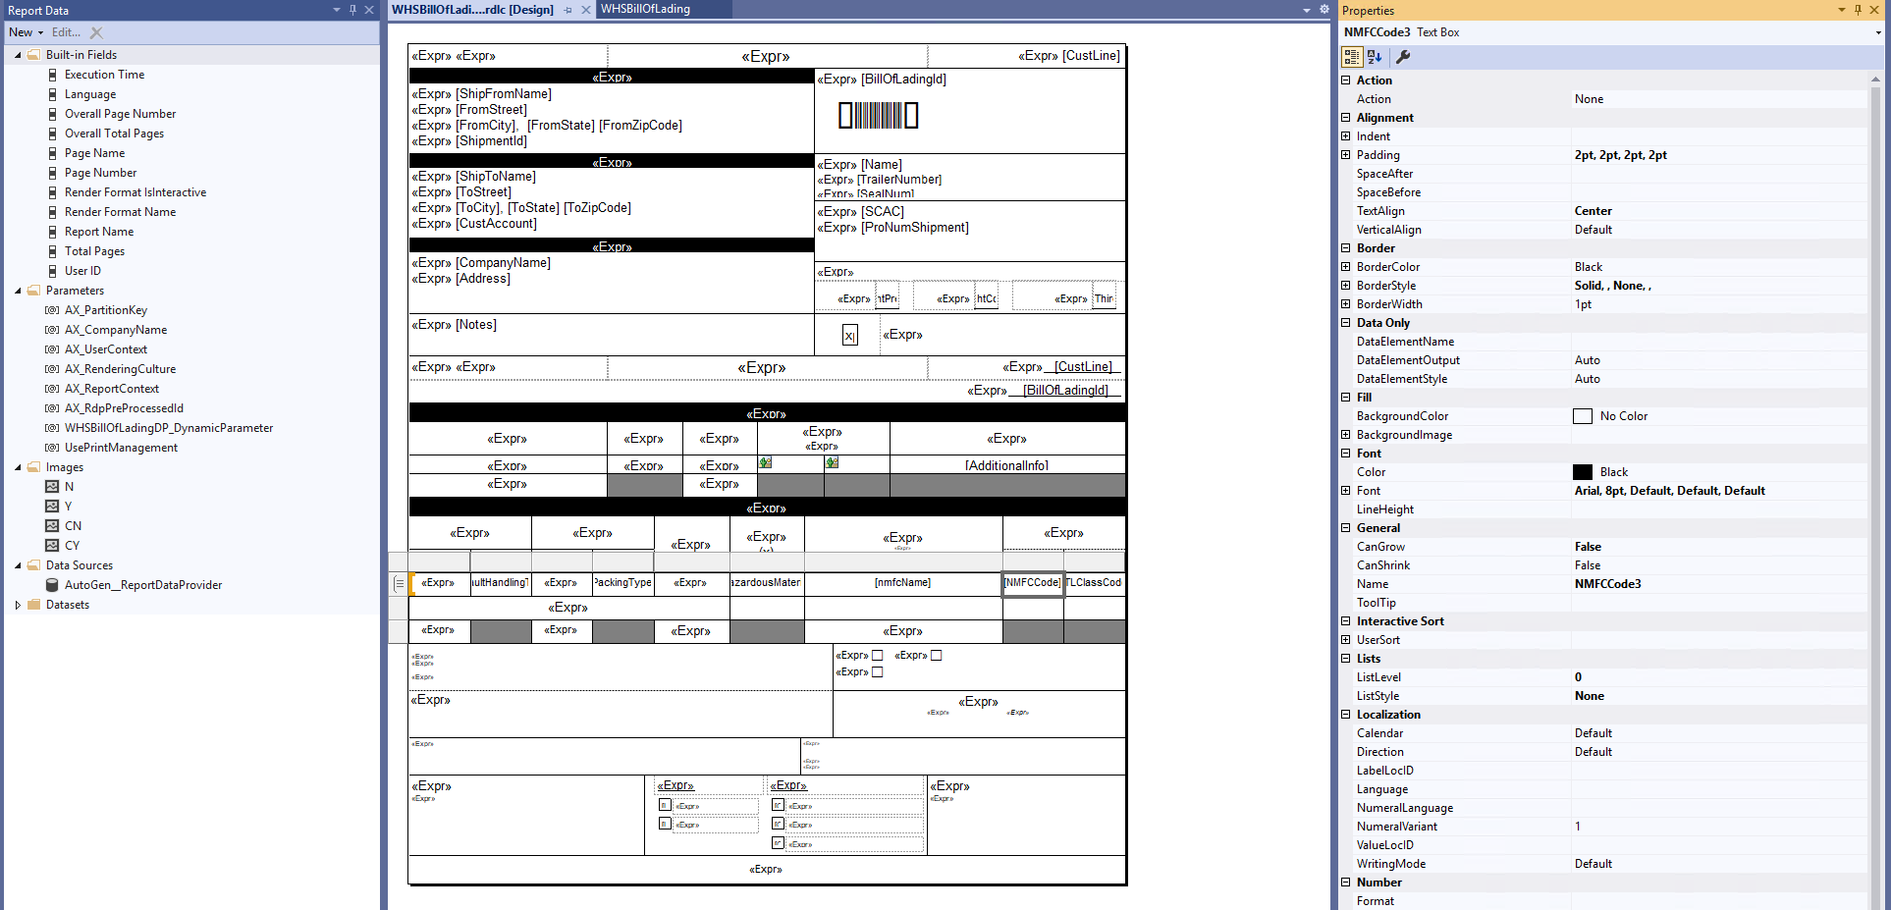
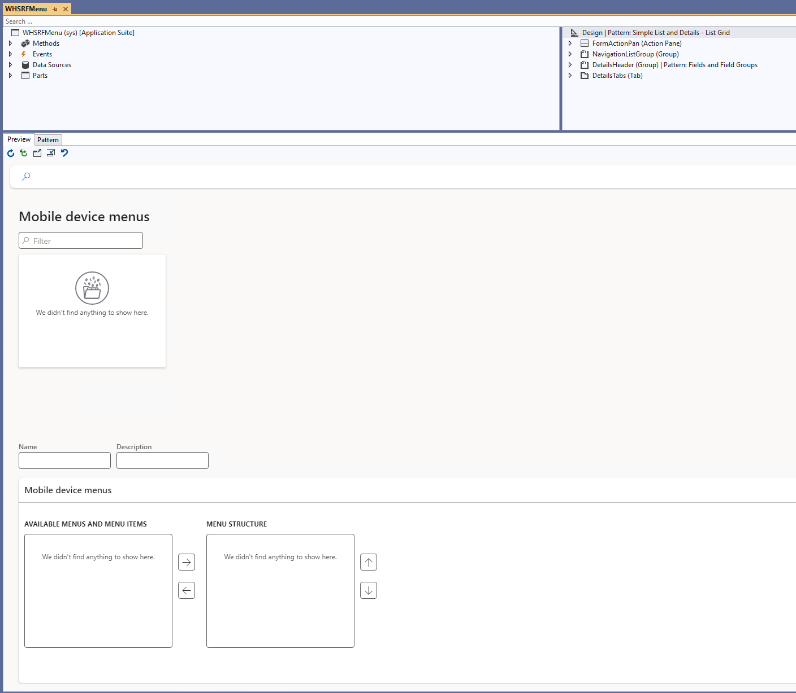
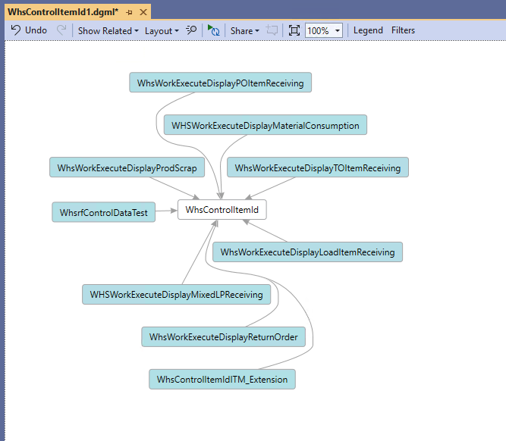
Microsoft Visual Studio
The most used IDE in the world
Visual Designers
Pages
Reports
Code flow
What you see = What you get
High ROI
Notes:
Visual Studio provides a rich design surface, what-you-see-is-what-you-get. For Dynamics 365 this includes a visual report designer, and a visual forms designer, and a visualization of code dependencies. All of this makes it much quicker to make the right changes.

Slide 10

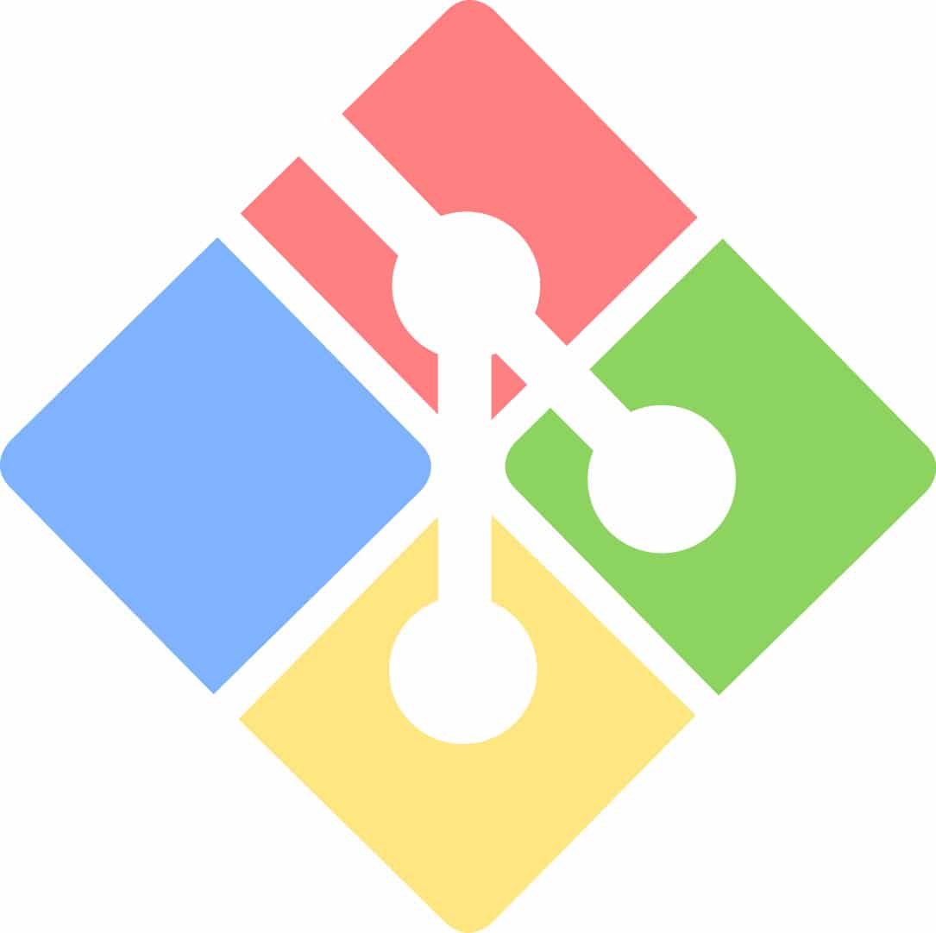

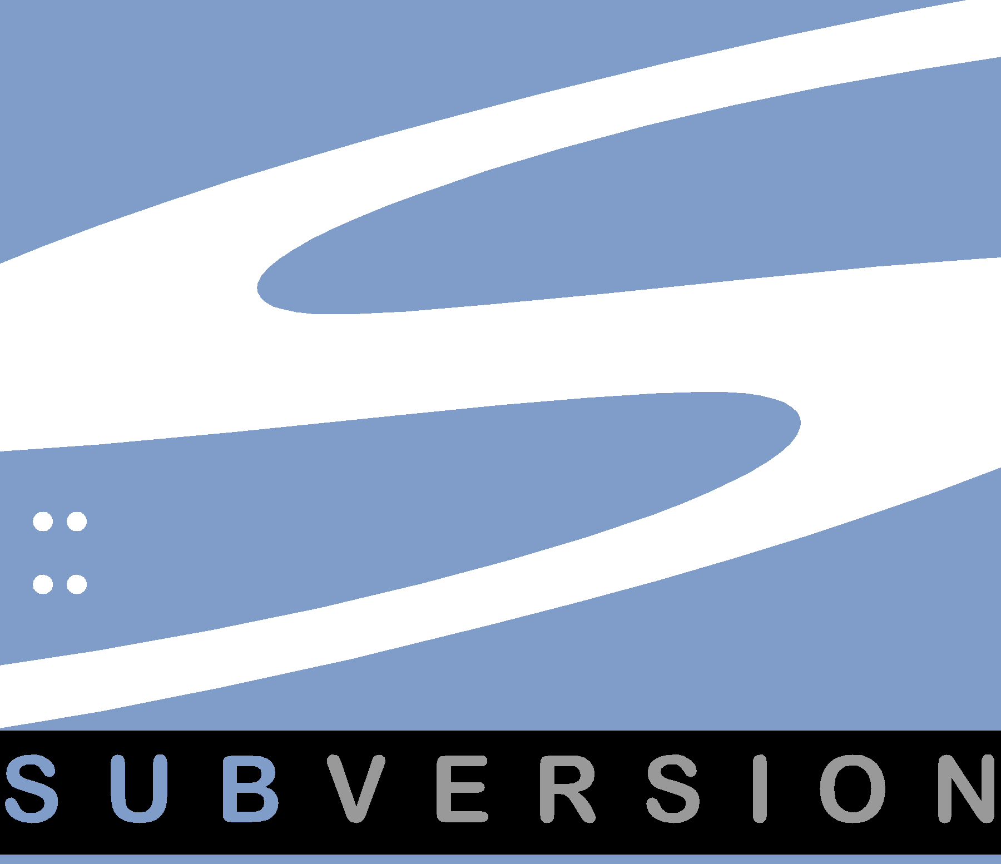
Microsoft Visual Studio
The most used IDE in the world
Visual Designers
Version Control
Git, GitHub, SubVersion, VSTS, …
State of the art concurrent development
Highly productive
Change tracking
Configurable Policy Gates
Notes:
Of course, Visual Studio supports version control, so you can track changes, collaborate in branches, implement gated check-in systems etc. Visual Studio supports literally any relevant version control system, including GIT and GitHub, Subversion, And Visual Studio Team System.

Slide 11
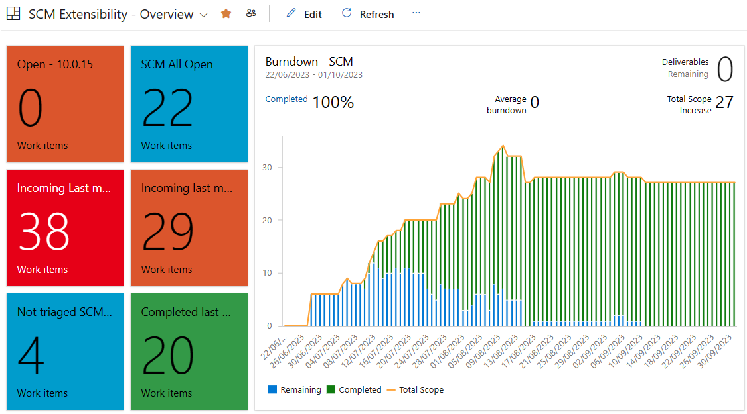
Microsoft Visual Studio
The most used IDE in the world
Visual Designers
Version Control
Project management
Work and tasks tracking
Team management
Agile methodologies
Predictability
Notes:
Further, Visual Studio has project management capabilities, so you can track work, assignments, progress, create status reports, and deliver your projects with predictability.

Slide 12
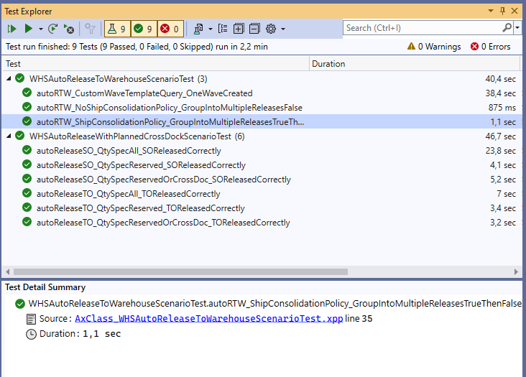
Microsoft Visual Studio
The most used IDE in the world
Visual Designers
Version Control
Project management
Automated testing
Confidence and early regression detection
Notes:
The last Visual Studio feature we want to highlight today, is the ability to write and execute automated tests. This is why engineers can sleep at night. With millions of lines of code, how do we dare make changes unless we with high confidence can prove the change work as intended and without negative side-effects. Automated tests in Visual studio gives you this.

Slide 13

Automated warehouse tests
2000+ warehouse scenario tests
Covering all warehouse business processes
Quickly write tests for variants
Ensure scenarios work with extensions
Notes:
Writing tests can be time consuming. With D365 you don’t have to start from scratch. Microsoft has made over 2000 warehouse scenario tests available for everyone. Covering warehouse functionality wall-to-wall.
This makes it a breeze for customers and partners to validate their own extensions, and write new test variants easily.

Slide 14
One toolbox
Same tools used by customers, partners, ISVs and Microsoft
VM provided with OneBox topology (Server, DB, Visual Studio, FnO Code, Demo Data, Tests)
Community Driven Engineering, enabling everyone to contribute to the standard application.
State-of-the-art tools available to everyone
Ecosystem benefits from all tooling innovations
Notes:
The tools I’ve shown today are of course available to customers and partners. It is the same tools that Microsoft Engineers use all day, every day. We provide a Virtual Machine Image, that can be hosted in Azure or locally, with everything you need to be a highly productive Dynamics 365 engineer.
Further, we have a Community Driven Engineering program, that in an open-source fashion allows partner engineers to create pull-requests to the standard product. This is naturally moderated by Microsoft, and so far we have received over 500 product improvements from the community. This is only possible, as we have a dedicated ecosystem of developers, and we are all using the same tools.

Slide 15
ISV network

Slide 16
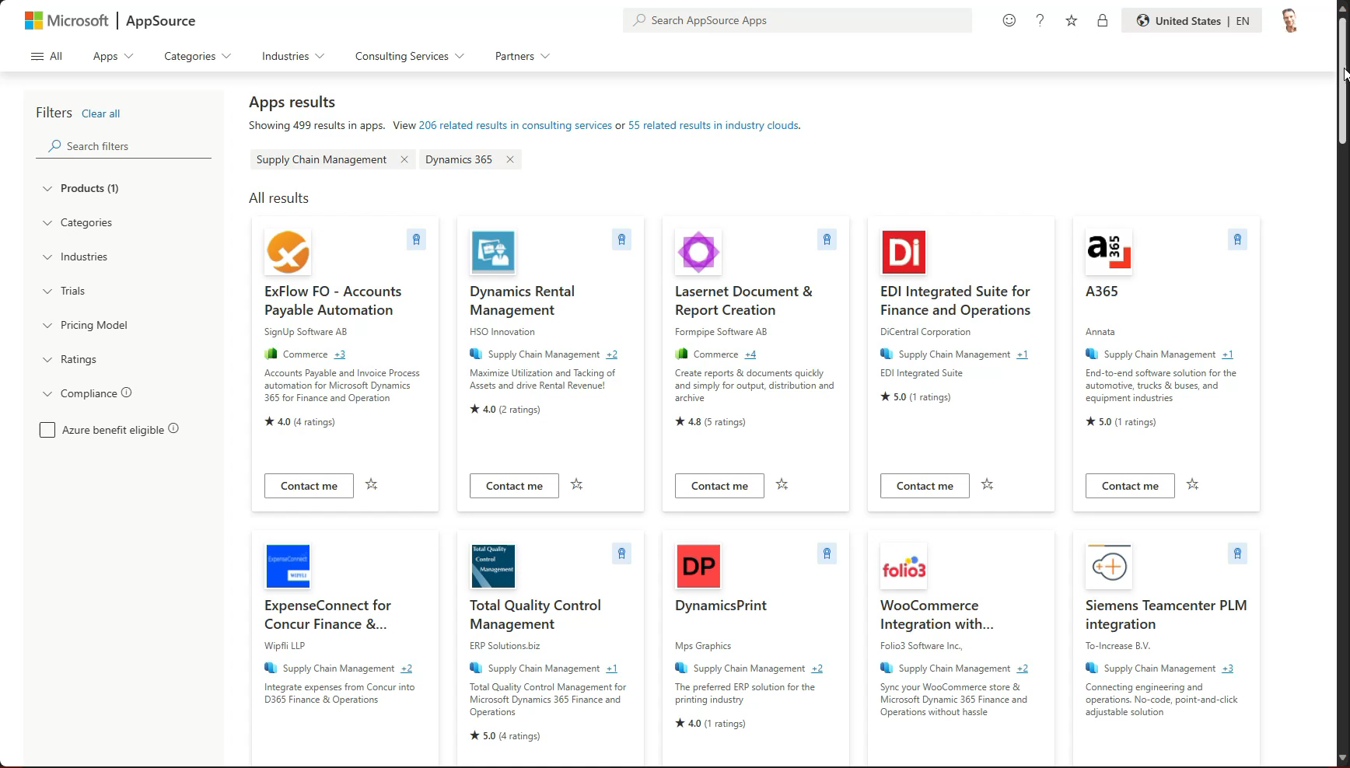
AppSource
Notes:
We’ve seen the pro-code tools, the X++ language and the declarative model. None of that matters unless it is used to build solutions. So let’s take a quick tour on AppSource, Microsoft’s marketplace for partner and ISV solutions. On AppSource you’ll find 500 solutions created by partners and ISVs. Each solution is certified to work with Dynamics 365. This happens as part of the publishing process. Further, we have a certification program for partners, ensure their knowledge, skills, practices and resources meets and exceeds customer expectations.
Here is an example of a solution- the solution is created by Invia robotics, and provides all the necessary integration to automate a warehouse using Invia’s innovative robots and subscription based business model – enabling scale-up of warehouse operations during for example peak season, while keeping operational costs low and predictable.

Slide 17
Low or no code
Notes:
Now we will highlight the capabilities both inside Dynamics 365 and within the greater Microsoft Platform which support low and no code customization to the solution

Slide 18
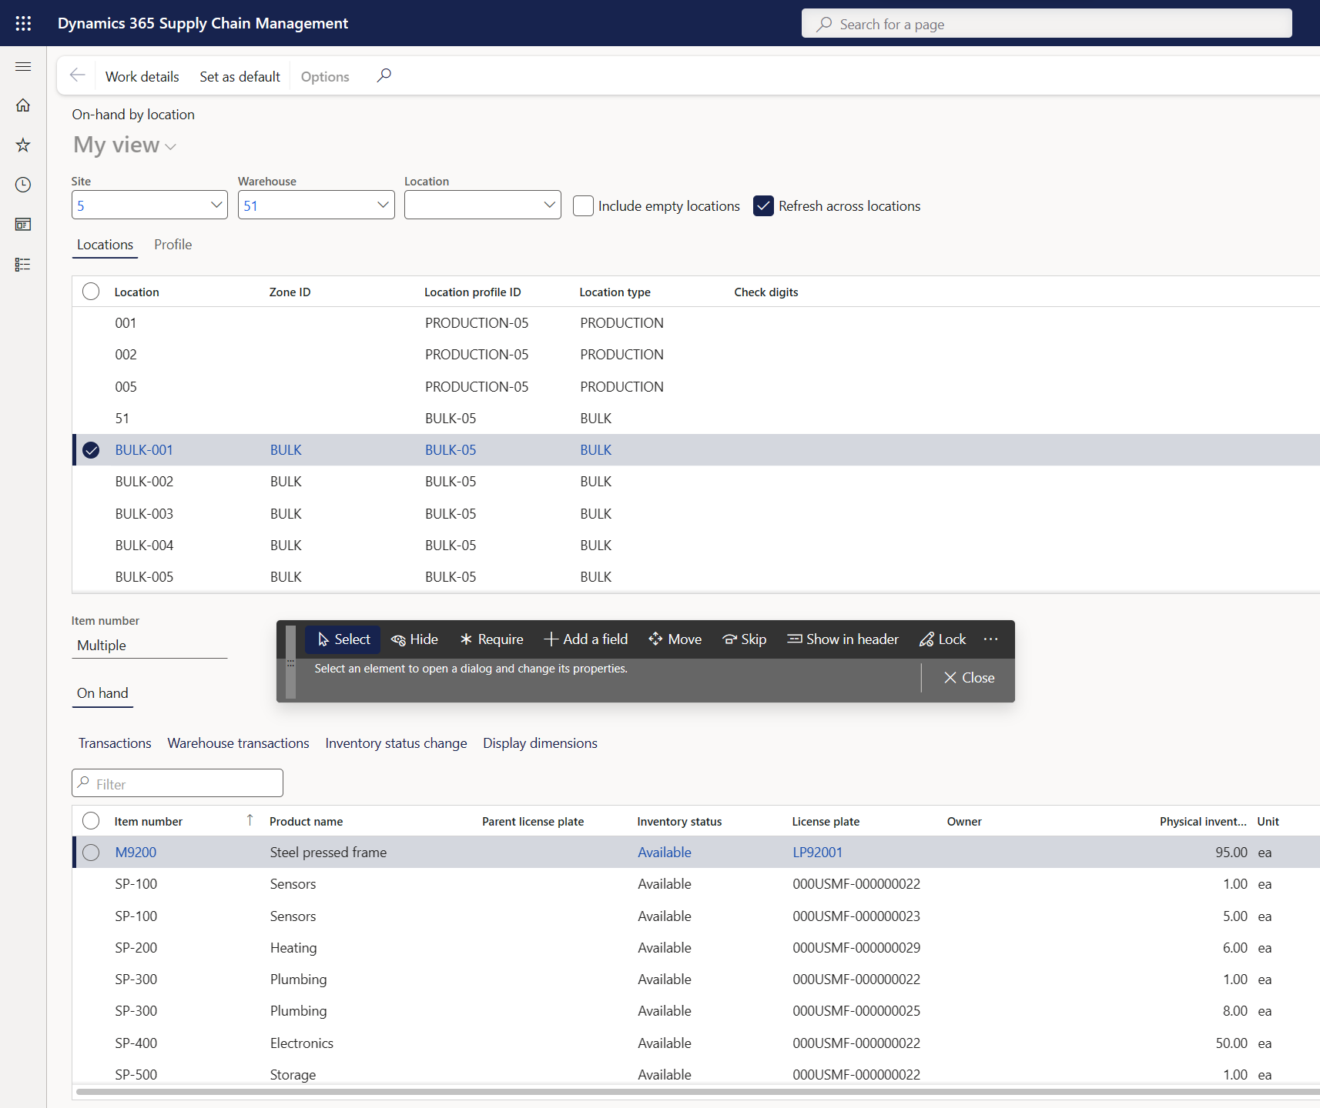
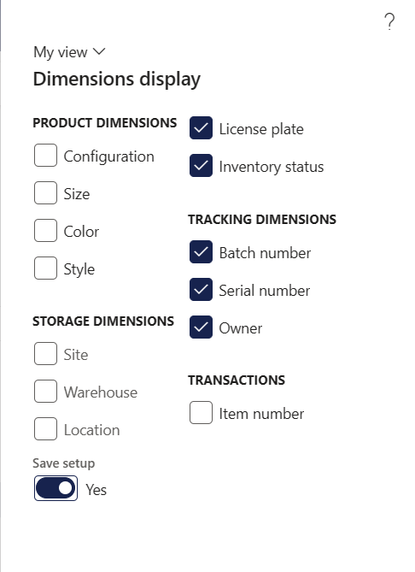
Form personalization
Notes:
The native user interface is also highly adaptable to business requirements – on the right you can see how form information can be selected based on different inventory dimensions, and on the left you can see the personalization tool which can be used to update each form to show only the information business users need – users can update forms themselves or standard views can be created for particular user roles

Slide 19
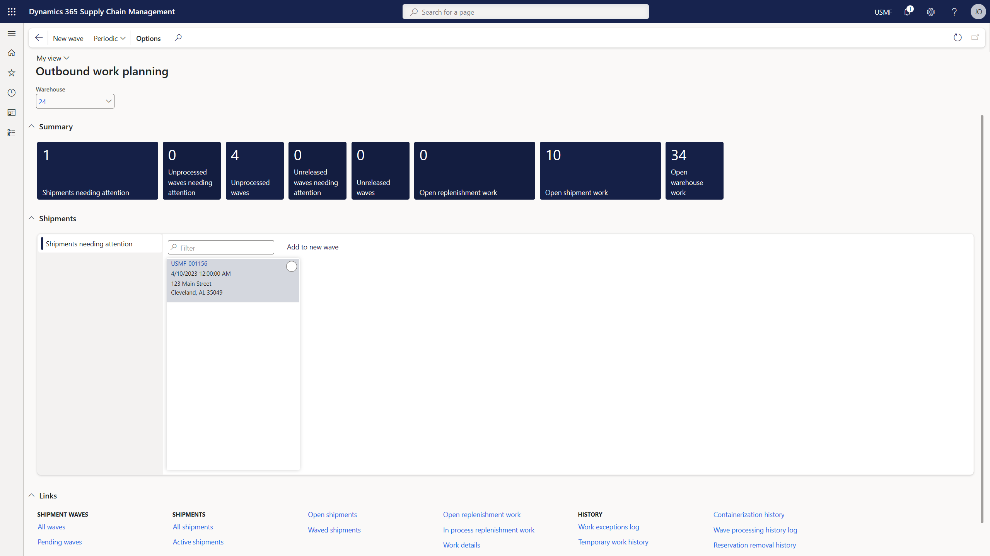
Workspace personalization
Tiles
Lists
Links
Notes:
Beyond the ability to adjust each form, we also provide workspaces out of the box which are designed to allow users to have a central hub to complete the tasks required for their roles. These workspaces can also be personalized without code to add tiles, lists, or links to relevant functions. you can also embed Power BI reports or dashboards into the workspace

Slide 20
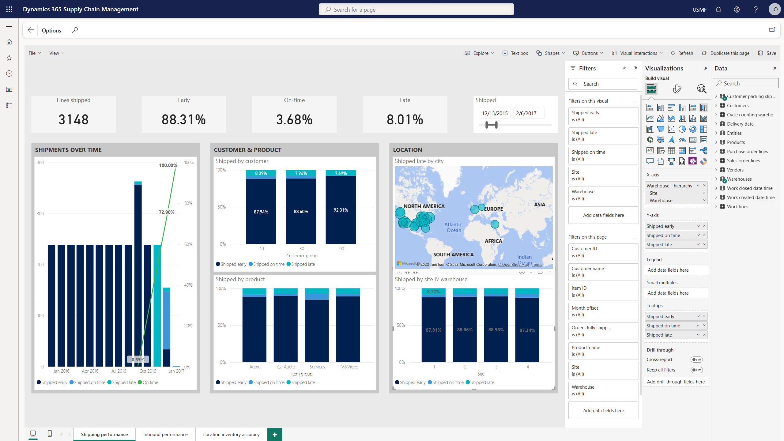
Power BI embedded experience
Notes:
And speaking of Power BI, as with many of the modules in Dynamics, the solution comes with several out of the box Power BI reports which can be adjusted inside the user interface to apply filters, change visualizations, or adjust data sources for the reports. This allows businesses to leverage the standard reports if they want or to adapt the reports based on their own needs. They can of course also develop their own Power BI reports and embed them as previously mentioned

Slide 21
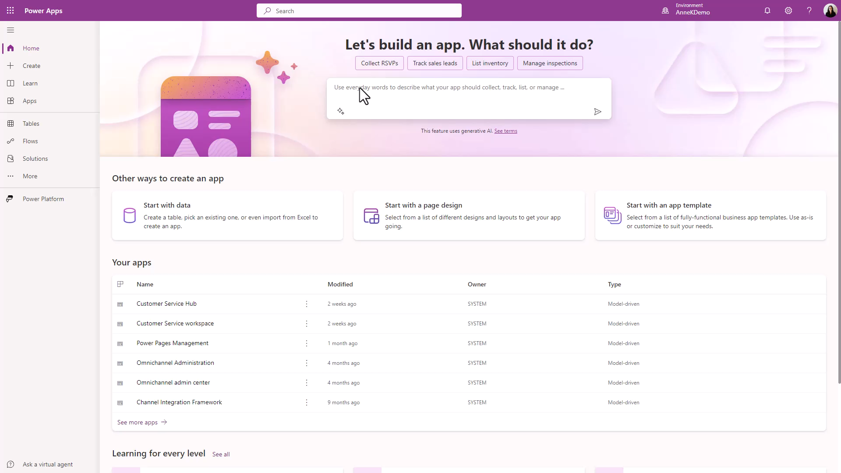
Notes:
Beyond personalization within the Dynamics 365 app, citizen developers can build low or no code power apps to support custom business requirement even faster than ever using Copilot in Power Platform. Users can describe the app they want to build using natural language, such as an app to manage cycle count exceptions. Copilot suggests the data tables to be used in the app and developers can easily make adjustments to the proposal with the copilot sidecar experience

Slide 22
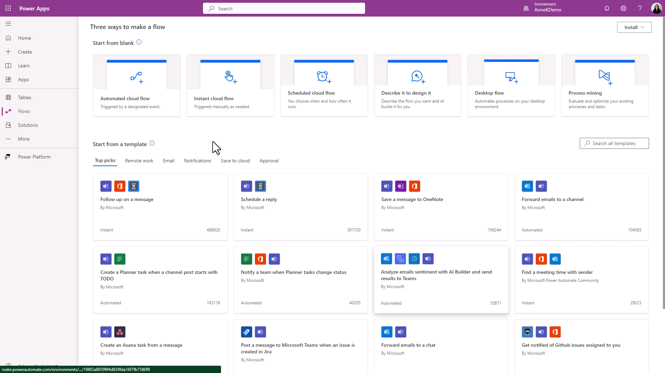
Notes:
Workers can similarly create new Power Automate flows to automate repetitive tasks in their day to day processes. In this example the user would like to send a teams message whenever the cycle count variance exceeds a certain threshold. Copilot proposes the low code Flow steps and from there the user can update and publish the flow. Copilot and Power Automate enable any user to easily add efficiency and increase productivity.

Slide 23
Summary
Extension model ensures seamless upgrades
Extensions cannot change standard code
Over 200k extension points
Best of breed tools support code development
Version control
Unit test
ISV Solutions
Industry vertical solutions
Rich market-place
Low code / No code
Power Platform to support low/no code development
AI infused to enable more citizen developers
Notes:
In summary, the Microsoft platform provides many options for extending the Dynamics 365 SCM solution. The extension model in the core codebase allows developers to support custom requirements wherever necessary without breaking the system during updates. The code development tools provided are best of breed and support robust version control of code releases. For users looking to utilize partner-packaged solutions which are reviewed and approved by Microsoft, ISV solutions provide a wide variety of offerings. For companies with their own developers, they can easily create low or no code solutions leveraging the Microsoft Power Platform and Copilot to solve business needs with a quick and custom solution.

